Slide 1

EC 1306- DIGITAL SIGNAL PROCESSING MINI PROJECT
Submitted Under the supervision of
Dr. Ujjal Chakraborty
Assistant Professor, ECE
Department of Electronics and Communication Engineering
National Institute of Technology Silchar
SUBMITTED BY:- Snehal Jha 1714115
Roshan Thakur 1714116
Varchasva Bharadwaj 1714117
Saransh Kumar 1714118
Prashant Jha 1714119

Slide 2

Cross-Correlation
This is a kind of correlation, in which the signal in-hand is correlated with another signal so as to know how much resemblance exists between them.
Mathematical expression for the cross-correlation of continuous time signals x (t) and y (t) is given by
$R_{xx}\left(T\right)=\int_{−∞}^{∞}{x\left(t\right)y^{∗}\left(t−T\right)ⅆt}R_{xy}\left(T\right)$=$\int_{−∞}^{∞}{x\left(t\right)y^{∗}\left(t−T\right)ⅆt}$
The cross-correlation of the discrete time signals x [n] and y [n] is expressed as
$$R_{xx}\left[m\right]=\sum_{n=−∞}^{∞}{x\left[n\right]y^{∗}\left[n−m\right]}R_{xy}\left[m\right]=\sum_{n=−∞}^{∞}{x\left[n\right]y^{∗}\left[n−m\right]}$$
Cross-correlation of any two given signals can be found via graphical techniques.
One signal is slid upon the other while computing the samples at every interval.

Slide 3
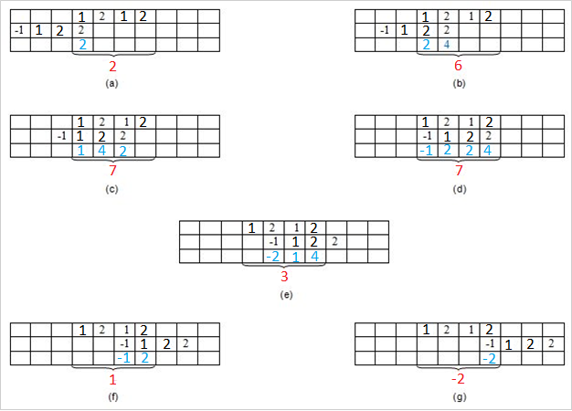

CROSS CORRELATION EXAMPLE
x= {1,2,1,2} and h = {2,2,1, -1}
The first set of samples (in the first row of every table) refers to the signal x [n] and the second set refers to the samples (in the second row of every table) of the signal h [n].
The samples shown in blue color—those in the third row—are obtained by multiplying the corresponding samples of the first two rows
Finally, we add the samples in the last row so as to obtain the samples of the cross-correlated signal.
Thus, here we see that the samples of the cross-correlated signal $R_{xy}$ are obtained as {2, 6, 7, 7, 3, 1, -2}.

Slide 4
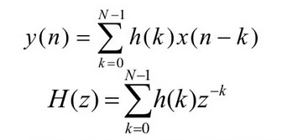
FIR FILTER
A basic FIR Filter is characterized by the following equations:
where h(k); k = 0, 1,…, N-1 are the impulse response coefficients of the filter
The order of the filter is N-1

Slide 5

LINEAR PHASE RESPONSE
A filter is said to have linear phase response if its phase response satisfies a relation of the type:
where α and β are constants
If β is zero, the filter will have constant group and phase delay responses and the impulse response of the filter will have even symmetry.
If β is non-zero, the filter will only have a constant group delay and the impulse response of the filter will have odd symmetry.

Slide 6
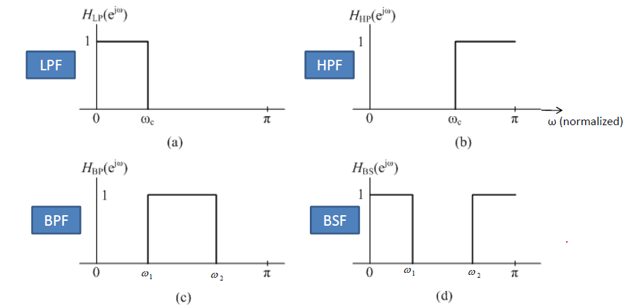
IDEAL FREQUENCY RESPONSES OF DIFFERENT TYPES OF FILTERS

Slide 7
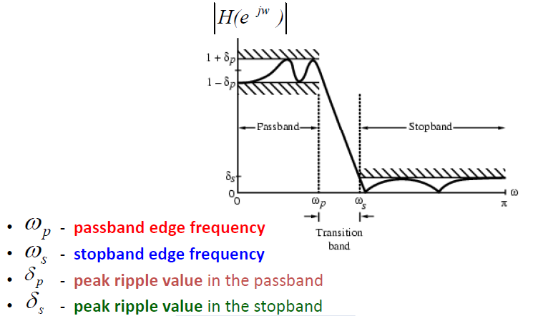


FIR FILTER SPECIFICATIONS
The peak passband ripple (in decibels) is given as:
The stopband attenuation (in decibels) is given as:
The transition width is defined as the difference between the stopband edge frequency and the passband edge frequency.

Slide 8
FIR FILTER DESIGN
For designing an FIR filter, the filter coefficients need to be calculated and specified.
There are several methods for this like window, optimal and frequency sampling methods.
All of the aforementioned methods can lead to linear phase FIR Filters.
The window method is an important method and will be discussed in greater detail.

Slide 9
WINDOW METHOD
The basic idea behind the window technique is to choose a proper ideal frequency-selective filter, which always has a non-causal infinite-duration impulse response.
The filter’s impulse response is then truncated to obtain a linear-phase and causal FIR filter.
This is why the choice of the ideal filter and an appropriate windowing function is crucial to this design technique.

Slide 10
STEPS INVOLVED IN THE WINDOW METHOD
Selecting the desired frequency response of the filter
Obtaining the impulse response of the desired filter by evaluating the inverse discrete-time Fourier transform
Selecting a window function that satisfies the passband or attenuation specifications
Determining the appropriate number of filter coefficients based on the relationship between the filter length and transition width
Multiplying the desired impulse response function with the window function to obtain the values of parameters and FIR coefficients
Shifting the filter coefficients by (N-1)/2 to obtain a causal filter

Slide 11
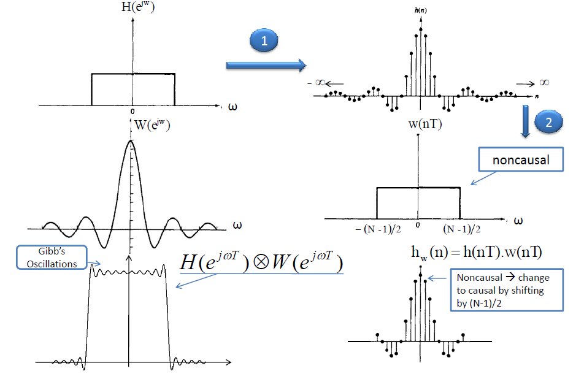
WINDOW METHOD (FLOW-DIAGRAM)

Slide 12
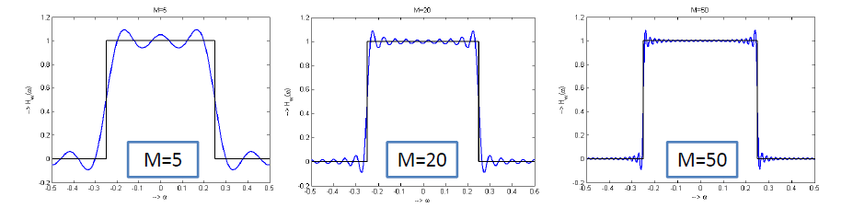
EFFECT OF WINDOW SIZE
As we increase the width of the window, the spectrum becomes sharper and the result of convolution will be closer to ideal.
As the resulting ideal impulse response does not lead to an FIR filter, the ideal impulse response can be truncated. This introduces Gibbs’ oscillations.
Filters designed by the window method have equal passband and stopband ripples.

Slide 13
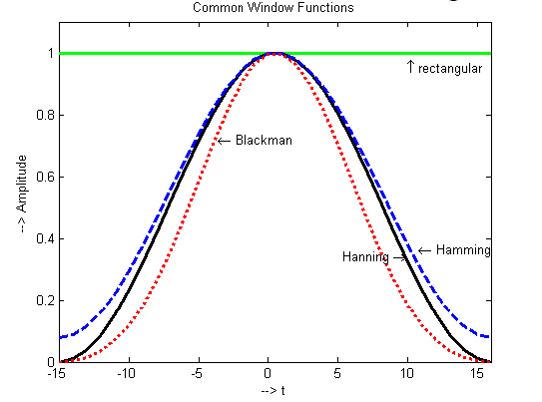
COMMON WINDOW FUNCTIONS
A practical approach to design an FIR filter is to multiply the ideal impulse response with a non-rectangular finite-duration window function. This helps reduce Gibbs’ oscillations by decaying the impulse response smoothly to zero.

Slide 14
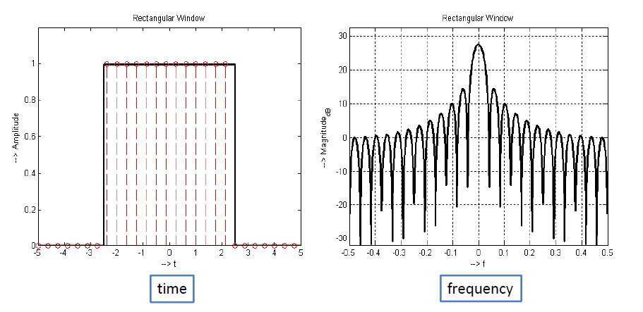

RECTANGULAR WINDOW
The rectangular window (sometimes known as the boxcar or Dirichlet window) is the simplest window, equivalent to replacing all but N values of a data sequence by zeros, making it appear as though the waveform suddenly turns on and off.

Slide 15
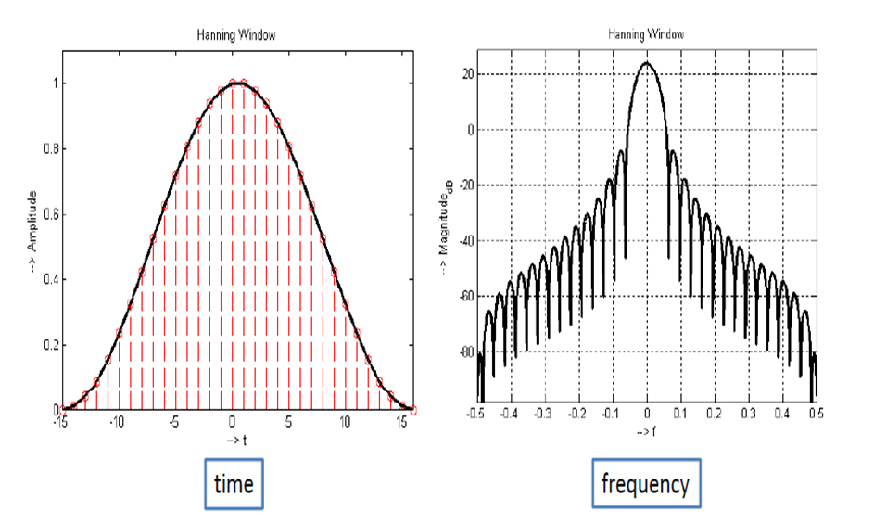
HANNING WINDOW
It is a Rectangular + scaled-cosine window
Cosine has one period across the window
Symmetric (zero or linear phase)
It is positive (by convention on and β)
Main lobe is 4ΩM radians per sample wide, where Ω_{M} ≞2*pi/M
Zero-crossings (``notches'') in window transform at intervals of Ω_{M} outside of main lobe

Slide 16

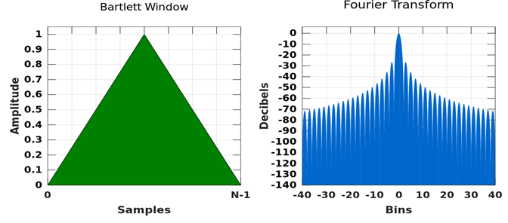

BARTLETT WINDOW
The Bartlett window (or simply triangular window) is given by
The corresponding transform is
Main lobe is twice as wide as that of a rectangular window of length M.
First side lobe twice as far down as rectangular case (-26 dB).
It is usually applied implicitly to sample correlations of finite data.
It is also called the ‘tent function'

Slide 17
KEY OBSERVATIONS
The window method of filter design is straightforward.
It requires a minimal amount of computational effort.
However, the resulting filter is not optimal.
In some cases, filters with fewer coefficients can be designed using other methods.

Slide 18
REFERENCES
Digital Signal Processing by Proakis
https://en.wikipedia.org/wiki/Cross-correlation
https://en.wikipedia.org/wiki/Finite_impulse_response
https://www.ukessays.com/essays/marketing/filter-design-using-rectangular-window-and-kaiser-window-marketing-essay.php

Slide 19
THANK YOU

